Slide 1
Bitcoin: The Future of Digital Currency
© 2024 all rights reserved

Slide 2

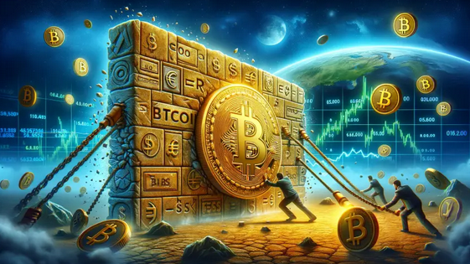
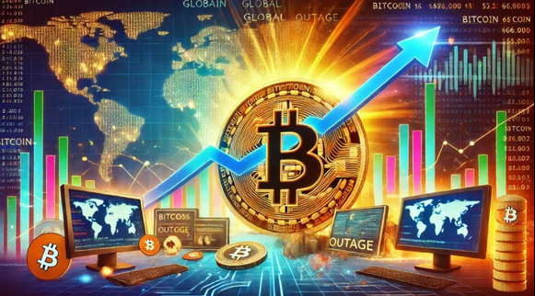
Introduction to Bitcoin
In the realm of digital currencies, Bitcoin stands as a revolutionary pioneer. This presentation explores the intricacies and opportunities within the Bitcoin frontier, highlighting its impact on the global economy and the future of ﬁnance.
What is Bitcoin?
Bitcoin is a decentralized digital currency created in 2009 by an unknown person or group using the pseudonym Satoshi Nakamoto. It allows for peer-to- peer transactions without the need for intermediaries, revolutionizing the way we perceive money.
© 2024 all rights reserved

Slide 3

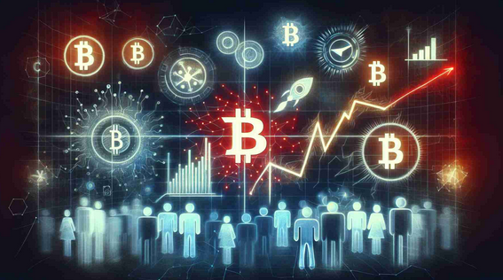
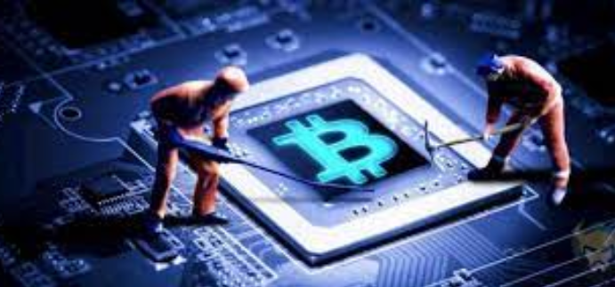
The Blockchain Technology
At the heart of Bitcoin lies blockchain technology. This distributed ledger records all transactions across a network of computers, ensuring transparency and security. Each block is linked to the previous one, creating an unbreakable chain of trust.
Mining: The Gold Rush
Bitcoin mining is akin to a modern-day gold rush, where miners use powerful computers to solve complex mathematical problems. Successful miners are rewarded with new bitcoins, contributing to the decentralized nature of this digital currency.
© 2024 all rights reserved

Slide 4


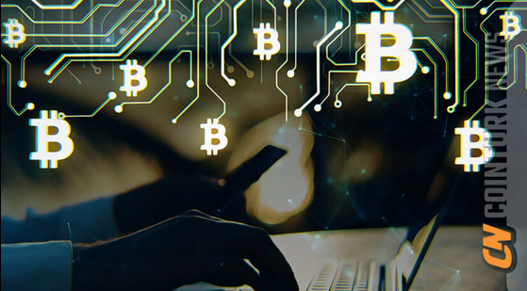
Volatility and Investment
Bitcoin is known for its price volatility, making it a double-edged sword for investors. While it offers potential for high returns, it also carries signiﬁcant risks.
Understanding market trends is essential for navigating this dynamic landscape.
Use Cases Beyond Currency
Bitcoin's utility extends beyond mere currency. It serves as a store of value, a means for remittances, and a tool for smart contracts.
These diverse applications showcase its potential to reshape various industries.
© 2024 all rights reserved

Slide 5
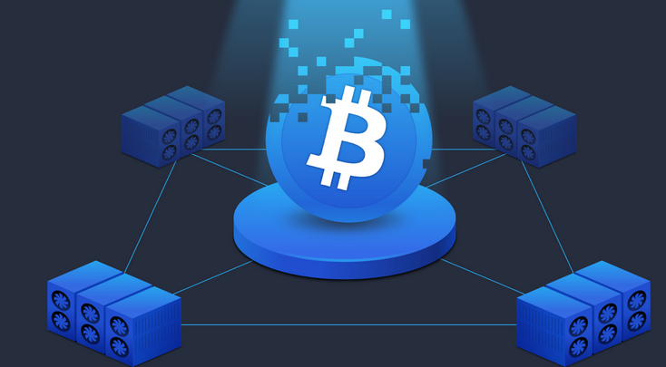
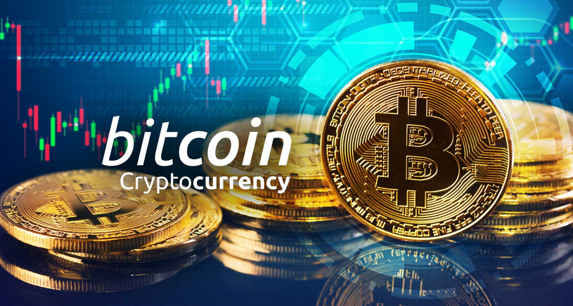
Regulatory Challenges
As Bitcoin gains popularity, it faces numerous
regulatory challenges worldwide. Governments are grappling with how to classify and regulate this digital asset, balancing innovation with the need for consumer protection and ffinancial stability.
The Future of Bitcoin
The future of Bitcoin is ﬁlled with possibilities. As technology evolves, we may see increased adoption, integration with traditional ﬁnance, and new innovations that enhance its functionality and security. The journey has just begun.
© 2024 all rights reserved

Slide 6

Challenges of Adoption
Despite its potential, Bitcoin faces challenges to widespread adoption. Issues such as scalability, energy consumption, and public perception must be addressed to foster a more inclusive ecosystem for all users.
Community and Culture
The Bitcoin community is a vibrant tapestry of enthusiasts, developers, and advocates. This culture fosters innovation, collaboration, and a shared vision for a decentralized future, driving the movement forward through passion and creativity.
© 2024 all rights reserved

Slide 7

© 2024 all rights reserved

